Slide 1

JOBIC 2015
“Transformation”
Nicolas Gutierrez Brum
Gerente de Negocios Corporativos
Microsoft Uruguay

Slide 2

THE WORLD HAS CHANGED

Slide 3
OF THE FORTUNE 500
IN 1955…
Notes:
Download this deck’s script at http://aka.ms/commercialstory

Slide 4
88
%
ARE GONE…
Notes:
Download this deck’s script at http://aka.ms/commercialstory

Slide 5
If the rate of change on the outside exceeds the rate of change on the inside, the end is near.
JACK WELCH
Notes:
Download this deck’s script at http://aka.ms/commercialstory

Slide 6



Microsoft – Our Past…
Future…
Client/Server/Productivity…
Transforming To The "Cloud First & Mobile First World"!
1
Digital
Work
Windows
Client OS
1
Windows
Client OS
1
4
2
Attach
&
Licenses
Attach
&
Licenses
2
2
Device
HW & OS
Users
Office &
Productivity
Workloads
Digital
Life
Office &
Productivity
Workloads
3
3
Windows
Server +
Enterprise
Windows
Server +
Enterprise
3
Cloud
OS
Notes:
Into the a Cloud first Mobile First World, into a Productivity & Platform company
New Reality Today: Users at the Center
Surrounded by Technology – Digital Work/Life, Cloud OS, Device HW and OS.
This will change the way we go to the market, how we work as Company and how we work individually. Of course there are going to be a lot of changes, but culturally speaking one the most relevant change is our new Performance and Development Approach. For this reason, I want to present this topic for you today.

Slide 7







The era of Personal Cloud
Microsoft Office 365
Devices
Social
Cloud
Management

Slide 8
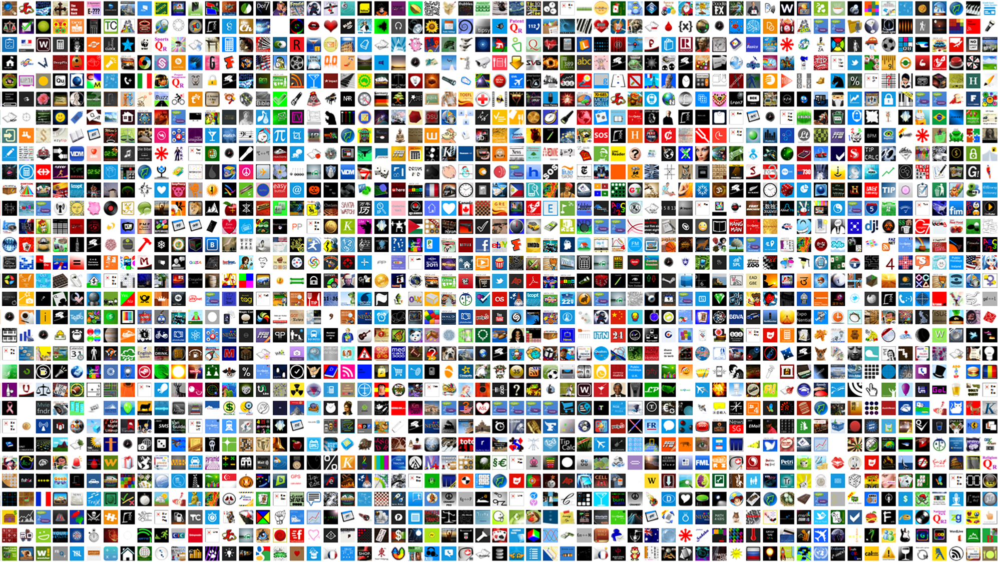

























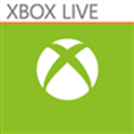









400,000+ Windows Apps

Slide 9
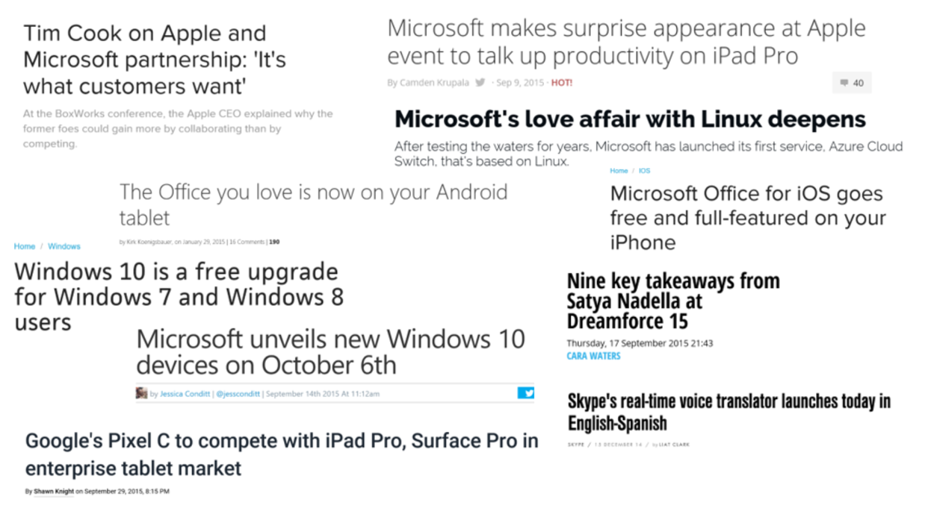

Slide 10
Gartner Top Strategic Technology Trends
Web-Scale IT
Hybrid Cloud & IT as a Service Broker
Cloud/Client Architecture
The era of Personal Cloud
Mobile Device diversity and management
Mobile Apps
3D Printing

Slide 11



Web Scale IT (Cloud Computing)
Microsoft Azure
IaaS
PaaS
SaaS
Infrastructure-as-a-Service
Platform-as-a-Service
Software-as-a-Service
host
build
consume

Slide 12




Mobile devices diversity and management
Microsoft Devices & Services
Devices with End-User Services
Services for the Enterprise
  Productivity
  Communication
  Entertainment
  Information Security
  Device Management
  Enterprise Solutions
  Flexible Cloud Platform

Slide 13














Hybrid Cloud & IT as a Service Broker/Cloud Client
Business Applications
Business Productivity
Application Platform
Core Infrastructure
On Premise
(Customer Datacenter)
Private Cloud
(Customer or Partner Datacenter)
Public Cloud
(Microsoft Datacenter)
Hybrid
Common Technologies: Identity - Virtualization - Management - Development Tools

Slide 14
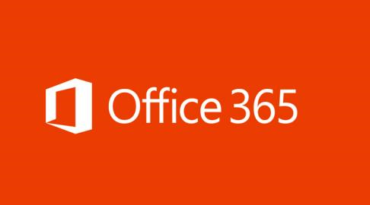
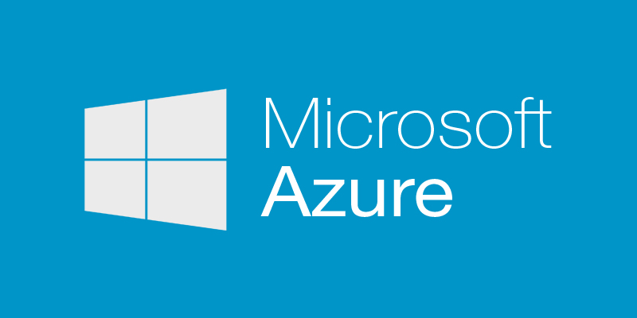

Slide 15
Microsoft demonstrates Office on iPad Pro
Apple always invites third-party developers to show off some of the most impressive new apps coming to its devices, but today it had something of a surprise guest: Microsoft

Slide 16
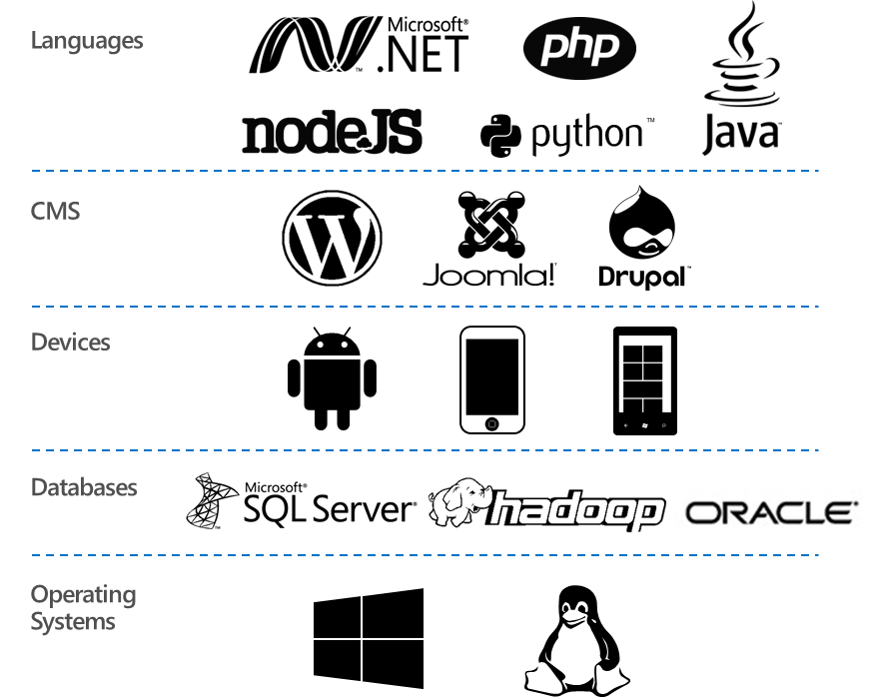
Microsoft Azure supports the broadest selection of Languajes, Devices, Databases and Operating Systems.

Slide 17
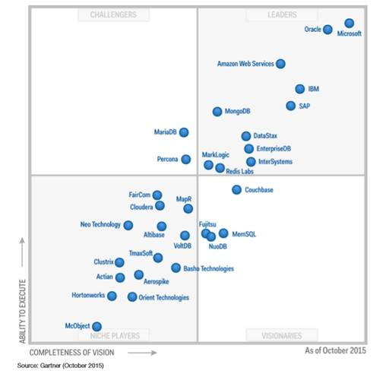
Microsoft, the new leader in Gartner´s Core Database magic quadrant!!!

Slide 18




Estemos en contacto…
nicolas.gutierrez@microsoft.com
gutierreznicolas10@hotmail.com
N_Guti
https://www.linkedin.com/pub/nicolas-gutierrez-brum/17/393/b94

Slide 19

Agradecimientos:
JOBIC 2015 Comisión Técnica Mixta Salto Grande
Alvaro Frioni afrioni@office2000.com.uy
www.office2000.com.uy

Slide 20
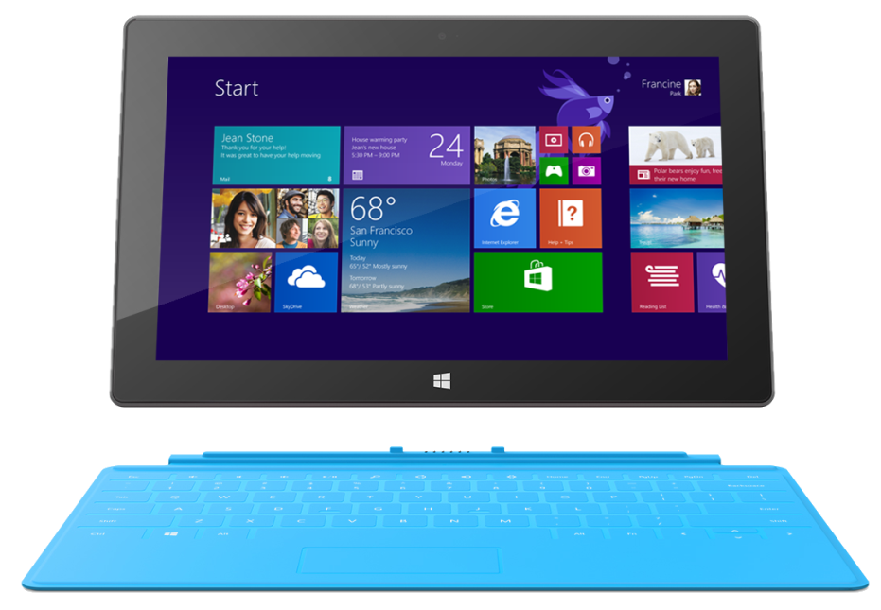
Mobile devices diversity and management
BYOD /System Center/Intune
Open standards
Use Open Mobile Alliance Device Management
Secure Communication with cloud based administration
Not requires add in for Windows 8.1 y Windows RT 8.1
Multivendor
Microsoft (Windows Intune)
AirWatch
Mobile Iron

Slide 21

© 2013 Microsoft Corporation. All rights reserved. Microsoft, Windows, Windows Vista and other product names are or may be registered trademarks and/or trademarks in the U.S. and/or other countries.
The information herein is for informational purposes only and represents the current view of Microsoft Corporation as of the date of this presentation. Because Microsoft must respond to changing market conditions, it should not be interpreted to be a commitment on the part of Microsoft, and Microsoft cannot guarantee the accuracy of any information provided after the date of this presentation. MICROSOFT MAKES NO WARRANTIES, EXPRESS, IMPLIED OR STATUTORY, AS TO THE INFORMATION IN THIS PRESENTATION.

